Slide 1
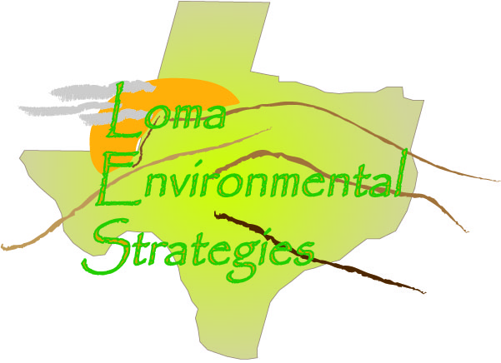
Loma Environmental Strategies
Assessment of Hill Country Land Use:
Records at the County Level

Slide 2
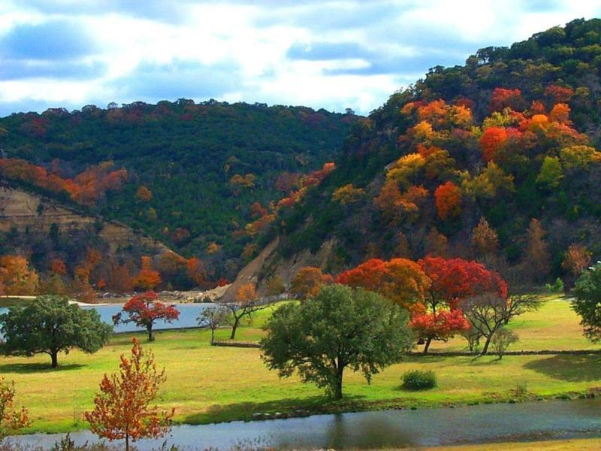
Agenda
Introduction
Analysis of Data Collection
Pilot Test
Budget & Timetable
Final Deliverables
Conclusion
Participation

Slide 3
Introduction & Scope
Scope:
The extent of our project is to provide Hill Country Alliance with maps showing land use change over 20 years.
Format method to project the impact of future development on the Texas Hill Country
Provide recommendations to standardize county data in order to update the information on a regular basis.
Issue(s)
Texas counties do not regulate zoning or monitor land use
No digital archive of previous land use
Problems evaluating land use change

Slide 4
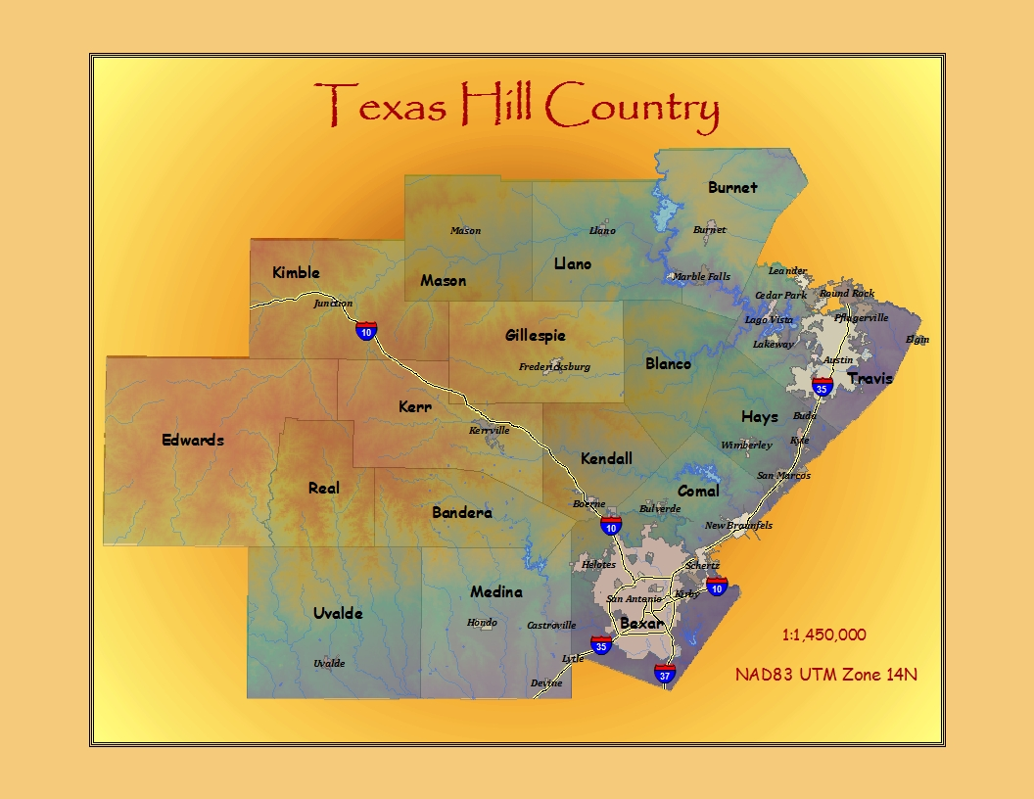

Slide 5
Hill Country Alliance

Slide 6
Analysis of Land Use Records
Evaluation of land use records in the Texas Hill Country
Identification of Sources
Create report detailing each county’s methods
Make recommendation for a standard procedure
Recommend a central clearing house to disseminate GIS Data

Slide 7
Pilot Test
Locational Analysis of Subdivisions in Hays and Blanco counties
Rapid Growth in the past twenty years
Proximity to Austin and San Antonio
Hill Country life style
Threats to the aesthetic appeal of the region
Impacts on natural resources

Slide 8
Pilot Test
Data
Official Public Records and County Appraisal District information
Data and files provide by the Hill Country Alliance
Methodology
Record research
Analysis of landscape change
Creation of Data Dictionary for subdivisions
Subdivision name
County ID number
Date platted
Date constructed
Acreage
Number of lots

Slide 9
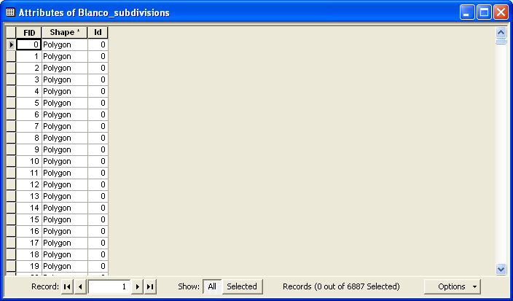
Attribute Tables

Slide 12
Timetable
 | Week 1 | Week 2 | Week 3 | Week 4 | Week 5 | Week 6 | Week 7 | Week 8 | Week 9 | Week 10
Data Collection
September 24-October 29
Pre-Processing
October 13- November 7
Analysis
October 17- November 19
Interpretation
November 17 December 3
Budget: $26,170.00

Slide 13
Resources
Kotch, Doris. Texas Association of Appraisal Districts. [Online]. September 20, 2008.
http://www.taad.org/contact_us.html
Valle, David. Hays Central Appraisal District. [Online]. September 24, 2008.
http://www.hayscad.com/Appraisal/PublicAccess/default.aspx
Texas Association of Counties. Welcome to Blanco County. [Online]. September 24, 2008.
http://www.co.blanco.tx.us/ips/cms/
ESRI. GIS and Mapping Software. [Online]. September 29, 2008.
http://www.esri.com/
USGS. USGS: Science of Changing the World. [Online]. September 17, 2008.
http://www.usgs.gov/
Texas Commission of Environmental Quality. Geographic Information Systems. [Online].
September 29, 2008. http://www.tceq.com/gis/index.html
Hill Country Alliance. Education, Conservation, Preservation. [Online]. October 1, 2008
http://www.hillcountryalliance.org/

Slide 14
Final Deliverables
(2) Reports
Maps
(2) CD’s
All data
Metadata
Proposal, Progress, Final Reports
Poster
PowerPoint presentations
Website

Slide 15
Conclusion
Introduction
Analysis of Data Collection
Pilot Test
Budget and Timetable
Final Deliverables
Conclusion
Participation

Slide 16
Contacts
Jason Arbogast – Manager
(512) 618-7951
ja1262@txstate.edu
Stanislaw Moszynski – Assistant Manager
(512) 608-3111
sm1415@txstate.edu
Chris Robertson – Analyst
(512) 296-0100
jr48864@txstate.edu
Joseph G. Butler – Data Management
(512) 554-1948
jb1615@txstate.edu

